Slide 1


Green Pace
Security Policy Presentation
Developer: Kendal GUizado

Slide 2

OVERVIEW: DEFENSE IN DEPTH
This model gives an overview of the detailed methods of defense we use in our field to maintain a solid blueprint for secure coding.

Slide 3
THREATS MATRIX
Likely STD-002-DAT STD-004-SQL STD-009-INS | Priority STD-001-CPP STD-002-DAT STD-003-STR STD-004-SQL STD-005-MEM STD-007-EXC STD-008-RNG STD-009-INS STD-010-THR
Low priority | Unlikely STD-001-CCP
Secure Coding come with certain levels of vulnerability to measure the impact of that certain standard. Here is a chart to prioritize those levels.

Slide 4
10 PRINCIPLES
1) Validate Input Data (STD-002-DAT, STD-004-SQL)
2) Heed Compiler Warnings – (STD-001-CPP)
3) Architect and Design for Security Policies (STD-003-STR, STD-007-EXC)
4) Keep it simple (STD-005-MEM, STD-008-RNG)
5) Default Deny (STD-001-CPP, STD-009-INS)
6) Adhere to the Principle of Least Privilege (STD-007-EXC, STD-00—INS)
7) Sanitize Data sent to other Systems (STD-002-DAT, STD-004-SQL)
8) Practice Defense in Depth (STD-001-CPP, STD-010-THR)
9) Use Effective Quality Assurance Techniques (STD-006-ASS, STD-010-THR)
10) Adopt a Secure Coding Standard (STD-003-STR, STD-008-RNG)

Slide 5
CODING STANDARDS
SQL Injection: STD-004-SQL (Very High)
Data Type: STD-001-CPP (High)
Data Value: STD-002-DAT (High)
String Correctness: STD-003-STR (High)
Memory Protection: STD-005-MEM (High)
Exceptions: STD-007- EXC (High)
Secure Random Number Generators: STD-008-RNG (High)
User Inputs: STD-009-INS (High)
Thread Safety: STD-010-THR (High)
Assertions: STD-006-ASS (Medium)

Slide 6
ENCRYPTION POLICIES
Encryption In Flight: Data transmitted over networks is protected using strong encryption protocols, such as TLS/SSL, to safeguard against interception and unauthorized access.
Encryption At Rest: Data stored on disk or other storage media is encrypted using robust algorithms to ensure that sensitive information remains secure even if physical storage is compromised.
Encryption In Use: Data being processed or actively used is encrypted to protect it from exposure during operations, ensuring that it remains secure throughout its lifecycle.

Slide 7
TRIPLE-A POLICIES
Authentication: Ensures that users are who they claim to be through mechanisms such as strong passwords, multi-factor authentication, and secure token management. Policies mandate robust verification methods to prevent unauthorized access.
Authorization: Controls access to resources based on user roles and permissions. Policies define clear access levels and enforce the principle of least privilege to ensure users only have access to what is necessary for their roles.
Accounting: Tracks and logs user activities to maintain an audit trail. Policies require comprehensive logging and monitoring of user actions to detect and respond to security incidents and ensure accountability.

Slide 8
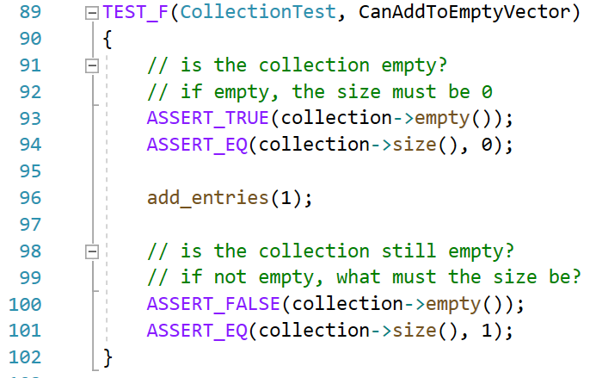
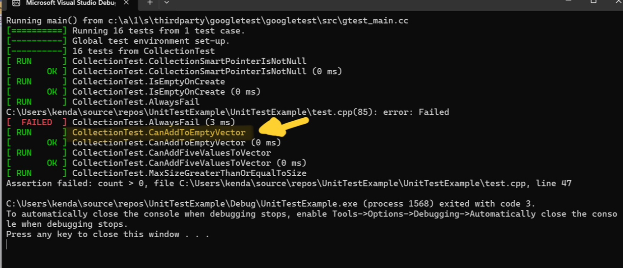
Unit Testing: CanAddToEmptyVector
This positive test verifies that a single value can be added to an initially empty collection.

Slide 9
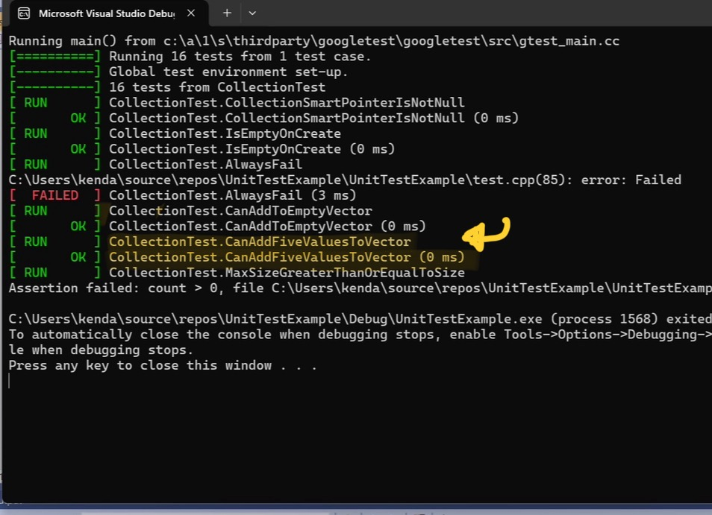
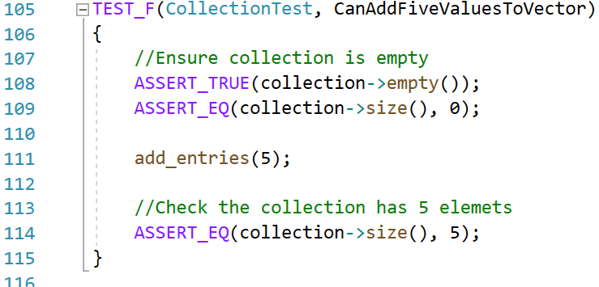
Unit Testing CanAddFiveAValuesToVector
This positive test checks whether adding five values to the collection works correctly.

Slide 10
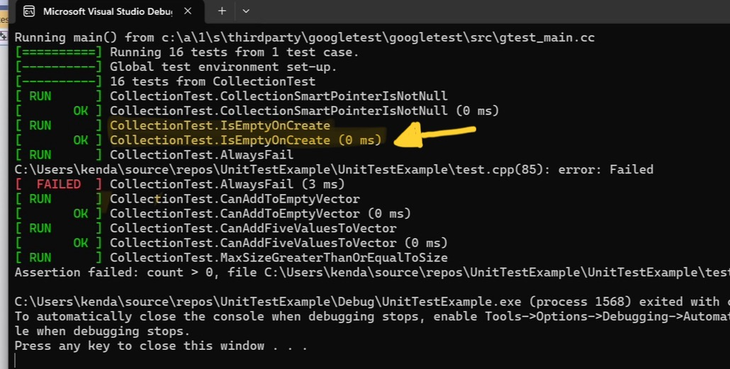
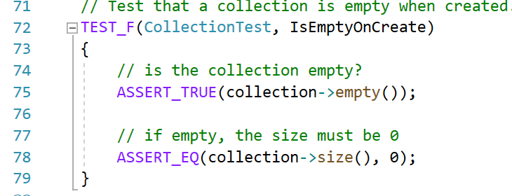
Unit Testing IsEmptyOnCreate
This test checks that a newly created collection is empty upon initialization.

Slide 11
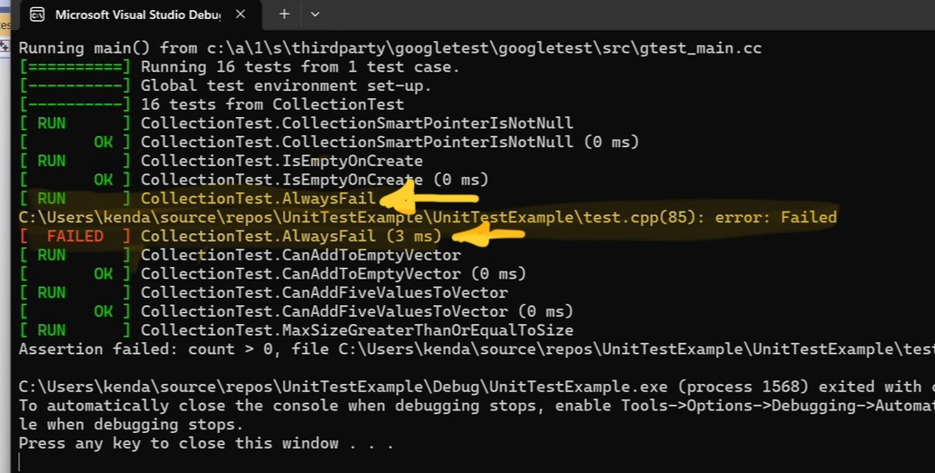
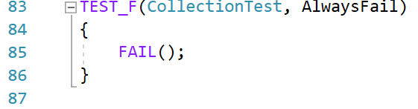
Unit Testing AlwaysFail
This test is intentionally designed to fail and is used to verify that the testing framework correctly reports failures.

Slide 12

AUTOMATION SUMMARY

Slide 13
TOOLS
DevSecOps Pipeline Overview:
Plan: Define security requirements and policies.
Code: Implement secure coding practices and static code analysis.
Build: Use automated security scans for dependencies and containers.
Test: Conduct dynamic security testing and penetration testing.
Release: Ensure security policies and controls are in place.
Deploy: Implement secure deployment practices and IaC security checks.
Operate: Monitor for security incidents with SIEM tools.
Monitor: Continuously review and update security policies and tools.
External Tools:
Static Code Analysis: SonarQube, Checkmarx
Dependency Scanners: OWASP Dependency-Check, Snyk
Container Scanners: Clair, Trivy
DAST: OWASP ZAP, Burp Suite
Penetration Testing: Metasploit, Nessus
IaC Security: Terraform, AWS Config
SIEM: Splunk, ELK Stack
CI/CD: Jenkins, GitLab CI

Slide 14
RISKS AND BENEFITS
Problems:
Undetected security vulnerabilities
Potential non-compliance with regulations
Solutions:
Integrate security at each DevSecOps stage
Use tools like SonarQube, OWASP Dependency-Check, and Splunk
Benefits of Acting Now:
Minimized risks and enhanced protection
Ensured compliance with standards
Risks of Waiting:
Increased risk of breaches and compliance issues
Reactive security measures, leading to potential damage

Slide 15
RECOMMENDATIONS
Standardize Practices:
Implement coding standards based on 10 security principles.
Continuous Testing:
Use external tools like OWASP ZAP for regular security scans.
Encryption Standards:
Apply encryption for data at rest, in transit, and in use.
Triple-A Framework:
Apply Authentication, Authorization, and Accounting practices.
Prioritize Risks:
Use a threat matrix to focus on high-risk vulnerabilities.
Future Policy:
Regularly update security policies to address new threats.

Slide 16
CONCLUSIONS
Current Gaps:
Incomplete threat modeling
Weak third-party dependency management
Limited continuous monitoring
Outdated incident response plans
Standards to Adopt:
NIST Cybersecurity Framework
Dependency management tools (e.g., Snyk)
SIEM tools (e.g., Splunk)
Updated incident response plans
Benefits:
Improved security posture
Better risk management
Faster incident recovery

Slide 17
REFERENCES
[Provide APA-style references with links to resources, articles, and videos that you used in your presentation.]

